Slide 1

LIVE TRANSLATOR
Under the guidance of
Mrs. Esther Varma
(Associate Professor)

Slide 2
Abstract
This tool helps in live translation from within 220 available languages to the other simultaneously as you speak.
Live translation helps us to understand the message appropriately and clearly without having it to type somewhere.
The other person will not know that we don’t know their language because we can understand what ever they speak using this tool.
Portable and not visible to anyone.
Helps to reduce the culture shocks and get settled in an environment quickly.

Slide 3


Existing System
There is No existing free tool that can do live translation.
Google’s Translator gives us the translation but that does not happen live and continuously.
Each phrase must be given as input separately to receive the output.
Google has implemented this live translation in their “PIXEL BUDS” as an exclusive feature but the device costs much higher and is not available across all countries.

Slide 4

Proposed System
This project does not use Google’s Translator to provide results.
Implements Machine Learning and Natural Language Processing (NLP) algorithms.
Uses the Language databases on the internet to keep itself updated with new improvements in grammar and pronunciation of words.

Slide 5
System Specifications Required to Run the Project
Hardware Specifications:
(Basic Specs are enough, but runs smoothly on,)
RAM: 4GB
Processor: 1.5ghz (Octacore)
High Speed Internet
Software Specifications:
Can run on any platform if developed
Web Based
Android
iOS
Windows
MacOs
Storage: 16GB

Slide 6
Modules and Procedure Involved
User interface to select languages.
Selecting FROM and TO languages from available 220 languages.
Translating given input speech to desired language.
Converting speech to text.
Giving output of converted speech.
Printing the converted speech
Converting text to speech and saving to the system.
Playing the saved output.
Translating from given language to desired language.

Slide 7
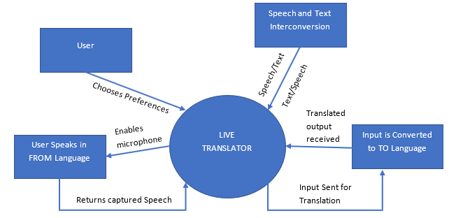
Dataflow Diagram

Slide 8
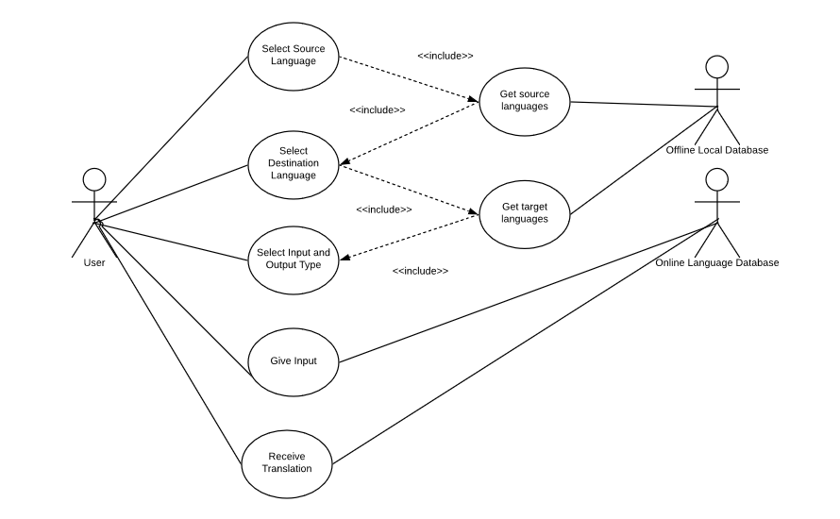
Use case Diagram

Slide 9
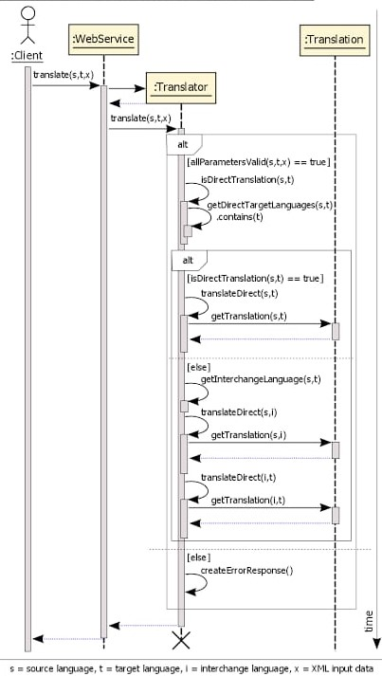
Sequence Diagram

Slide 10
Advantages and Disadvantages
Advantages
As it uses an online database, it is regularly updated with latest grammar rules and pronunciations and the translation done is appropriate.
Occupies less storage on physical device as the script is run using internet on the respected servers.
Disadvantages
Works only when internet is active as it uses online database for accessing language details.
Requires High speed internet connection and a favorable environment for perfect translation.

Slide 11
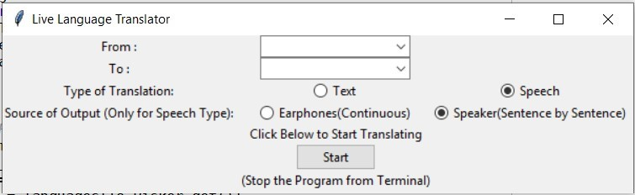
Screenshot 1 - GUI

Slide 12
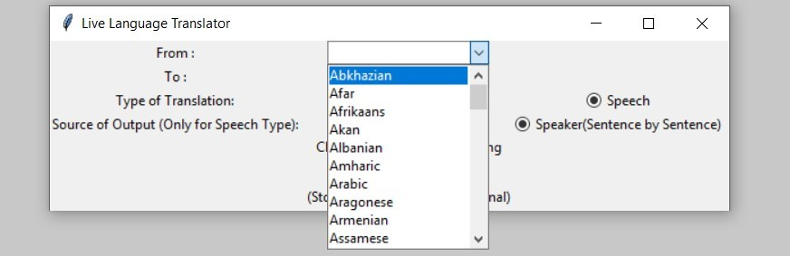
Screenshot 2 – Language Selection

Slide 13
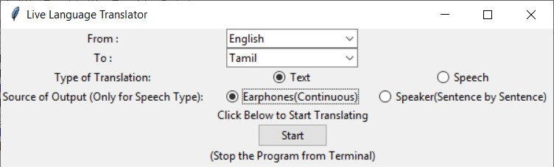
Screenshot 3 – Text Translation GUI

Slide 14
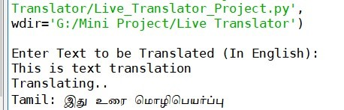
Screenshot 4 – Text Translation Example

Slide 15
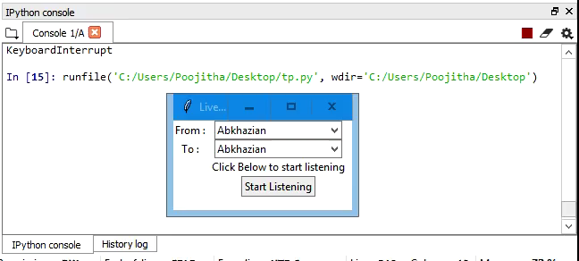
Demo

Slide 16


